Slide 1



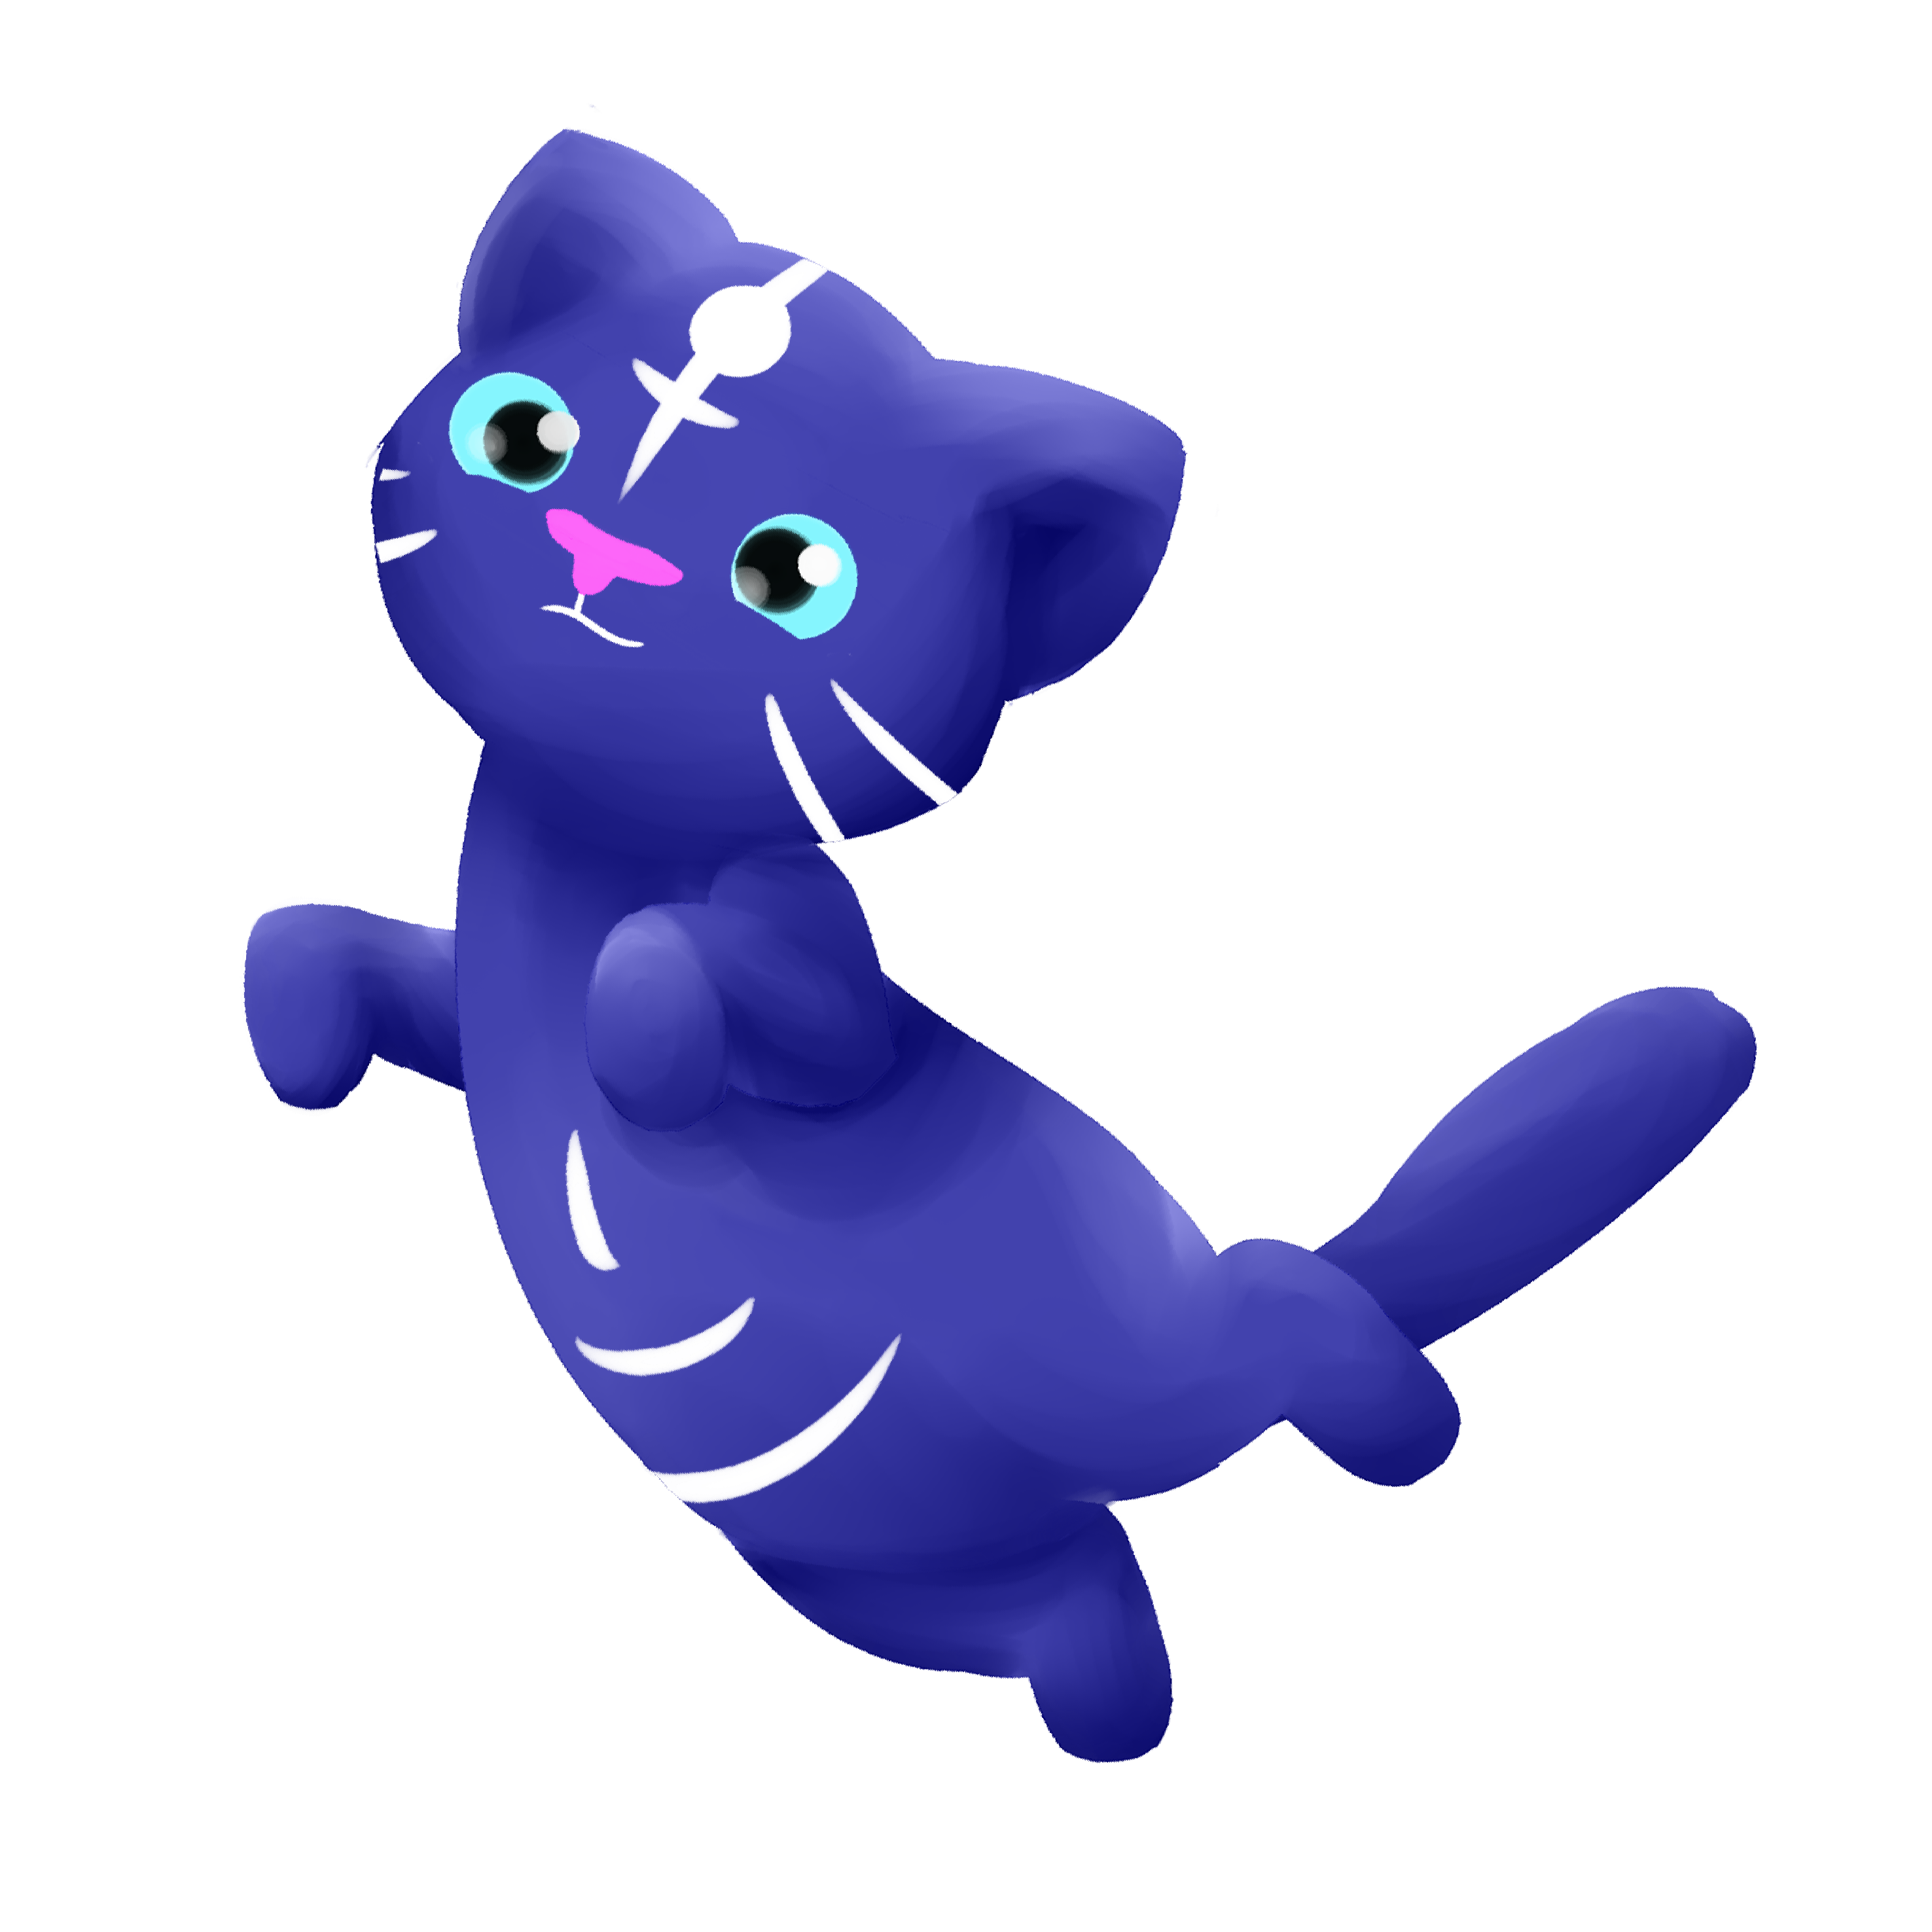
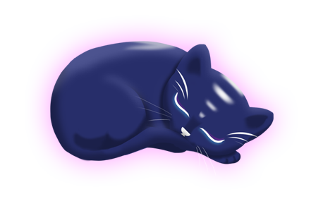

Group 6
Charlie Crewe, George Flude, Alex Polley and Callum Walsh.

Slide 2
Psychograph
Name: Maarii
Age: 48
Occupation: Admin/Sales
Marital Status: Married
Likes:
Chocolates
Toffees
Biscuits
Apple Pie
Green Tea
Earl Grey
v
Animals
Cats
Dogs
Horse
Music
Country Rock
80’s Pop
Fears/Dislikes
Insects
Large Dogs
Scaled creatures
Heights

Slide 3
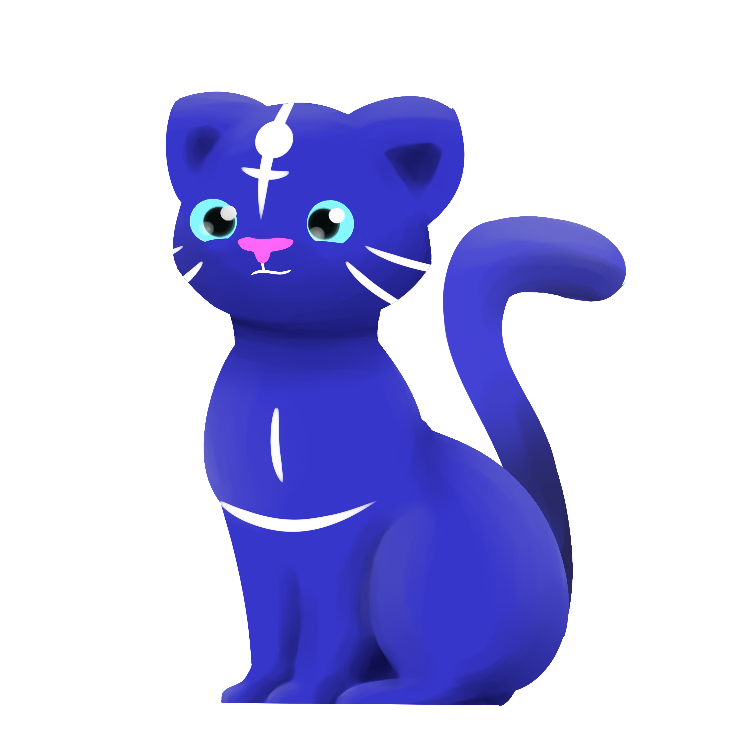
Platform
Tablet
Screen size suitable for psychographic

Slide 4
Gameplay

Slide 5


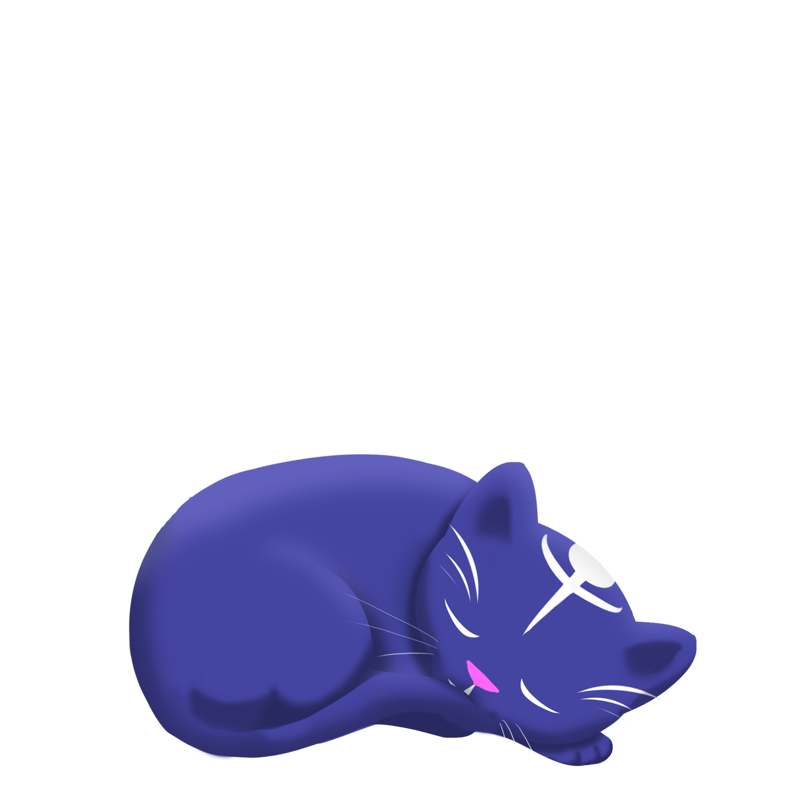


UI Elements
Tap the cat to show the UI
Non-invasive

Slide 6
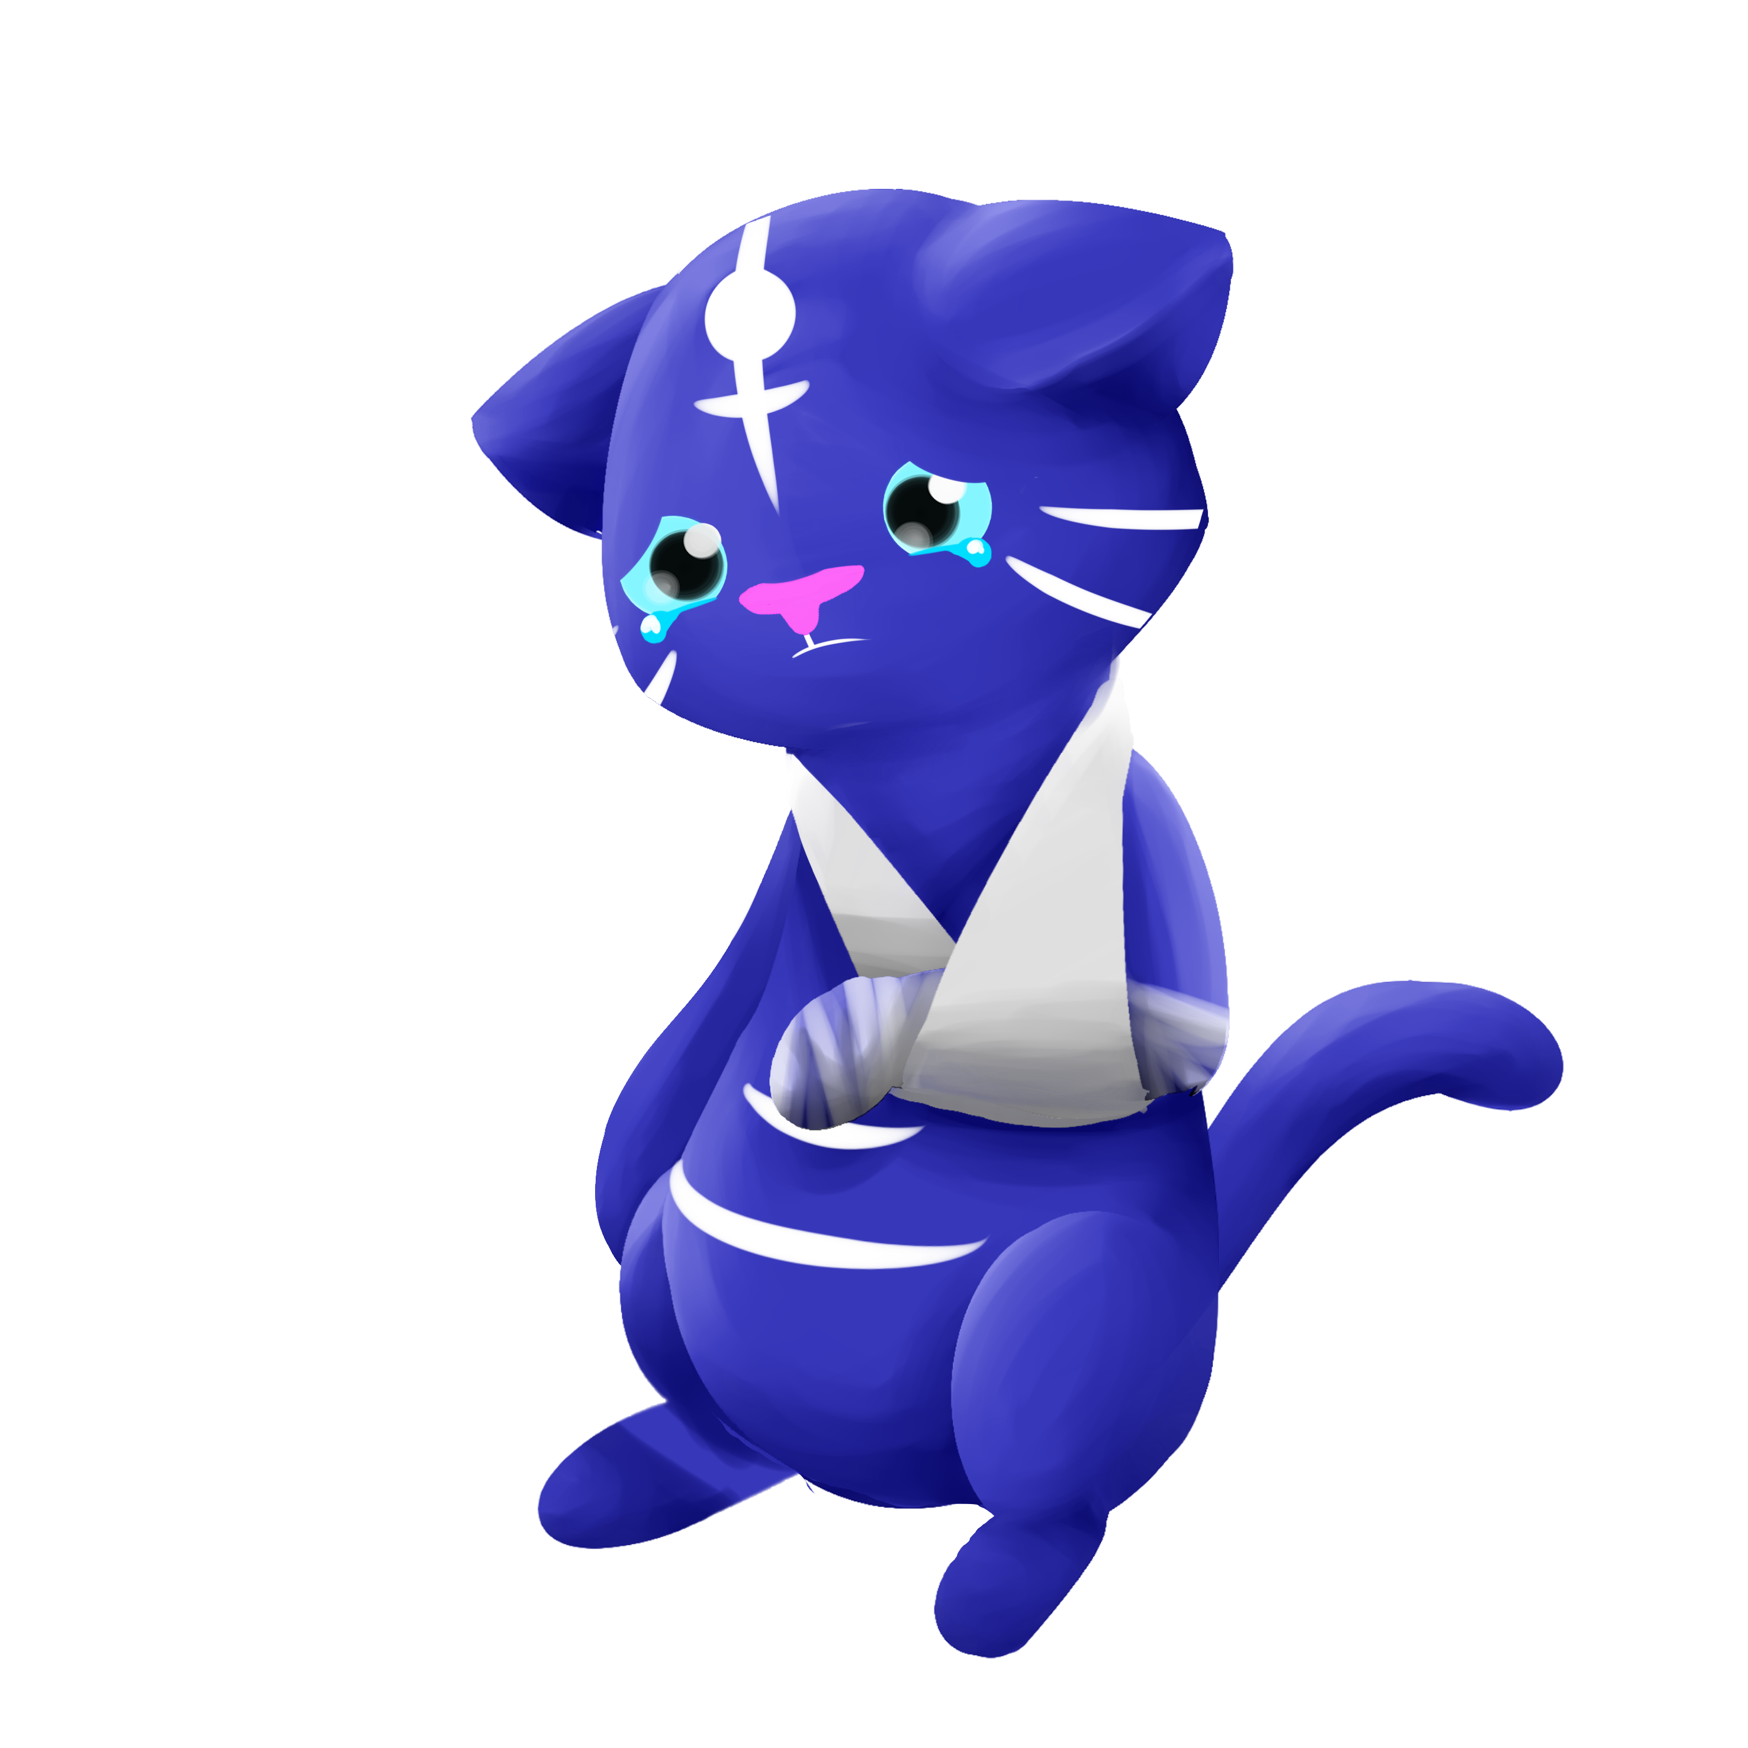
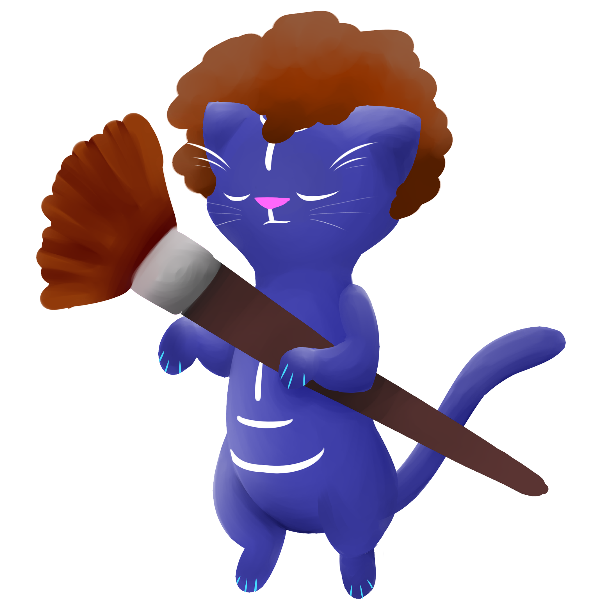

Animal Sprites

Slide 7
Usability Testing
Positive feedback
Art was pleasing
Players enjoyed interacting with the environment.
Liked the freedom of being able to choose colour

Slide 8
Usability Testing
Constructive feedback
Input felt unsatisfying
Some of the colours were over-exposed
UI interfered with game a lot

Slide 9
What we have done
Polish
Fixed colouring values that weren’t working
Rebuilt scenes outside of the prototype version
Visual feedback
Particle effects
Cat sprites

Slide 10
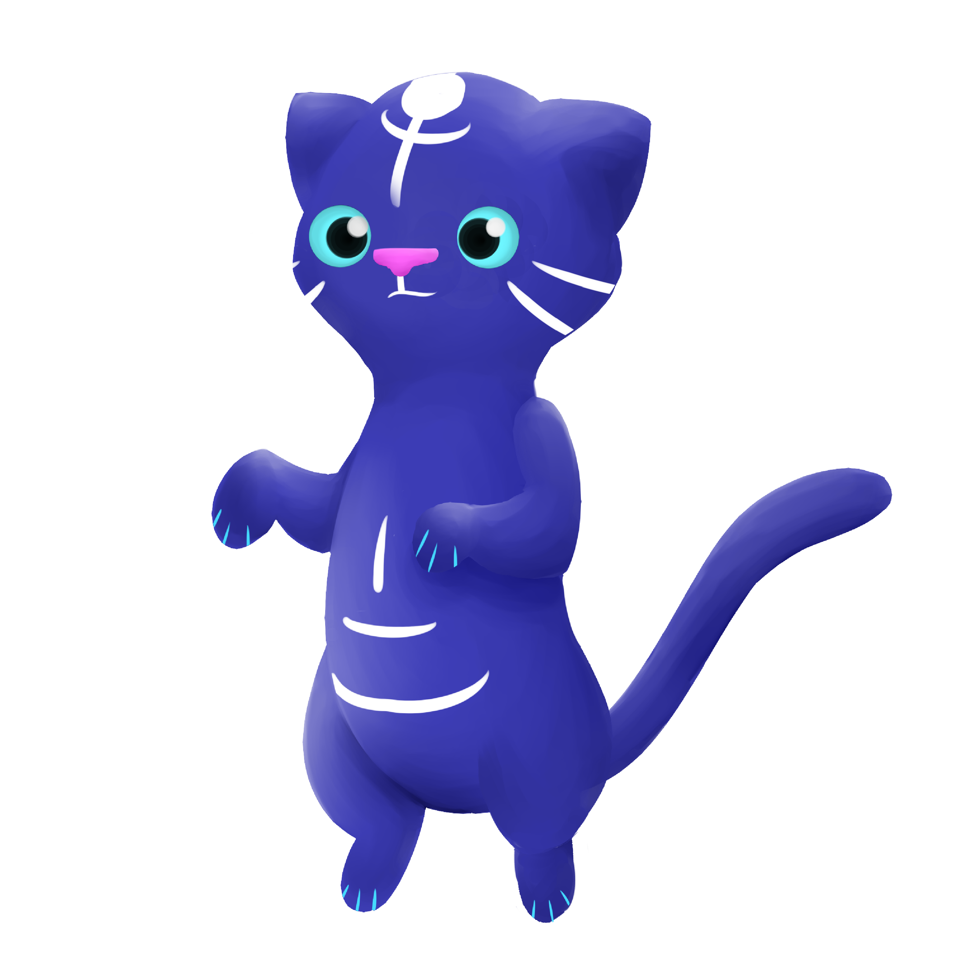
What needs to be done
Polish
Zoom Coding
Link the reward to the particles and sprites
Audio feedback
Ambient sounds
Music
Sound effects

Slide 11
Any questions?

